Slide 1
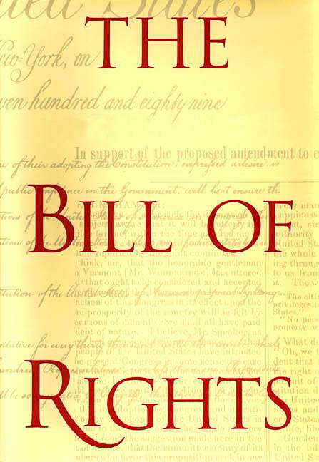
The First 10 Amendments
to the U.S. Constitution

Slide 2

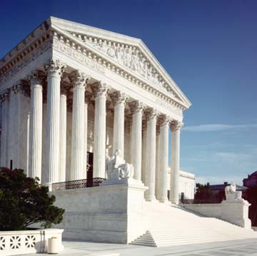
Who determines what the Bill of Rights means?
The Supreme Court makes rulings on the meaning
The Supreme Court balances the rights of the individual with the needs of society
Individual??
Society??

Slide 3
Five Rights in the First Amendment
Freedom of Religion
Freedom of Speech
Freedom of the Press
Freedom of Assembly
Petition the Government

Slide 4
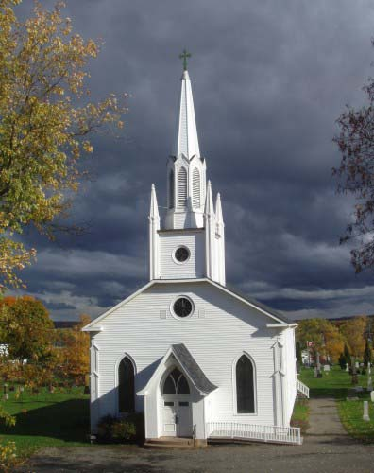
Freedom of Religion
“Congress shall make no law respecting an establishment of religion or prohibiting the free exercise there of”

Slide 5

Free Exercise—The person
Can Cannot
Choose whatever religion
Lead a prayer in most examples
Ask questions about religions
Worship whomever you want
Break the law and claim it is religious belief
Raise children without education
Deprive children of basic needs

Slide 6

Free speech– The individual can:
Say any political belief
Protest (without getting out of control)
Say things about someone that are true
Burn the flag
Say racist and hate slogans
Free speech means someone
might say something you
disagree with

Slide 7
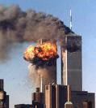
Free speech—limits on the person
Threaten to blow up airplanes, schools or the president
Create too much chaos
Extremely crude language in a public place
Disrespectful, vulgar language
in schools
Hate crimes

Slide 8

Freedom of the press
Can Cannot
Print any political position
Make fun of people, especially politicians
Expose wrongs by the government
Say things you might not agree with
Libel– intentionally injuring a person’s reputation by false facts
Disclose defense-security secrets
Detail how to make
certain weapons

Slide 9
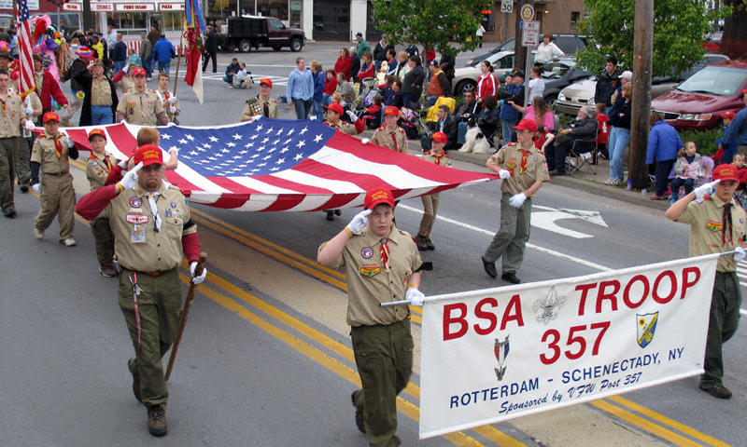
Freedom of Assembly—Individual
Can Cannot
Protest
Parade (with a permit)
Parade chanting hate slogan
Protest by throwing rocks and breaking windows
Hang out on private land against owners will—loitering
Violate teen curfew

Slide 10
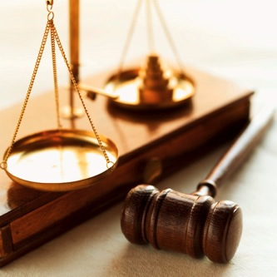
Petition the government
You may sue the government for wrongs
You cannot be punished for exposing wrongs by the government
The courts decide the
wrongs

Slide 11
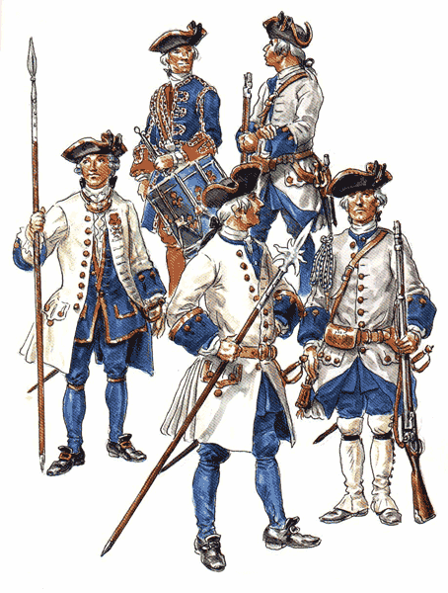
2nd Amendment—Right to bear arms
“A well-regulated militia, being necessary to the security of a free state, the right of the people to bear arms shall not be infringed.”

Slide 12
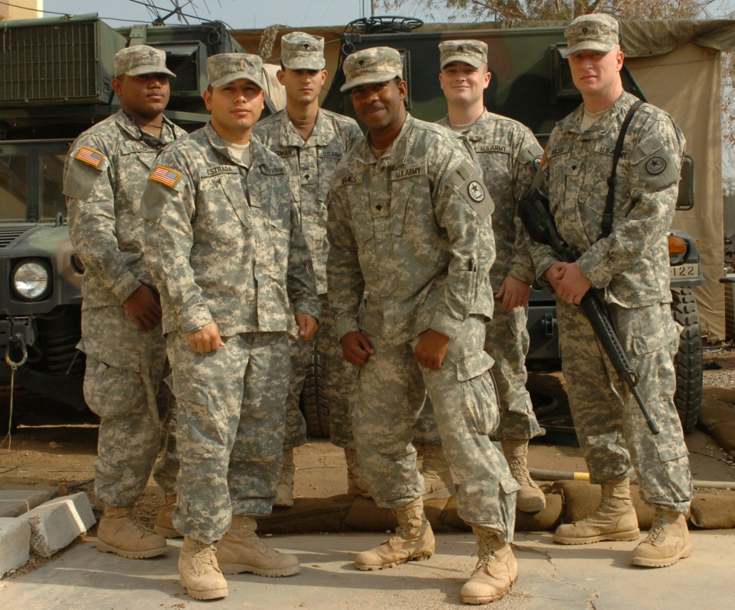
Third Amendment
The Government cannot force you to shelter soldiers in your home without your consent in time of war or peace.

Slide 13

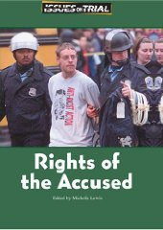
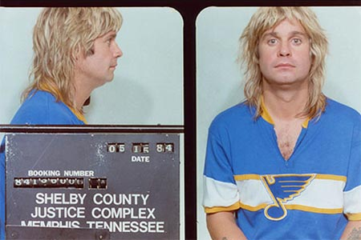
Rights of the Accused Amendments #4-8
Important to preserve freedom

Slide 14
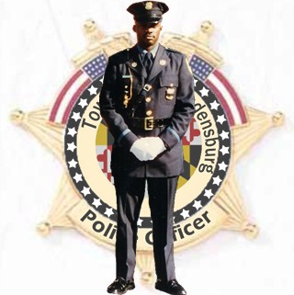
Fourth Amendment
What does a policeman need in order to search your home?
  A warrant given to him by a judge
  Probable cause is also needed

Slide 15
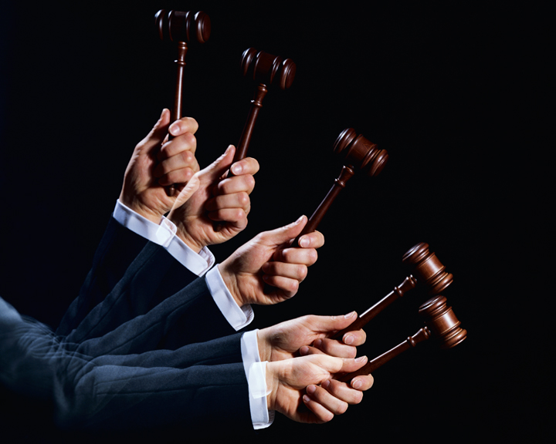
Fifth Amendment
You cannot be tried for the same crime twice—called “Double Jeopardy”
You do not have to testify against your self. “I plead the fifth”
You must have due process of law before you are convicted
The government cannot take
your land unless it pays.

Slide 16
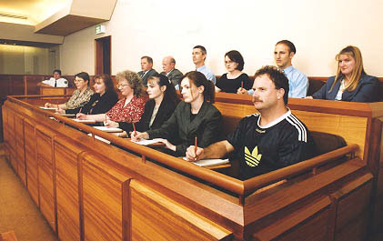
Sixth Amendment
Right to speedy trial by impartial jury—meaning not favoring either side

Slide 17
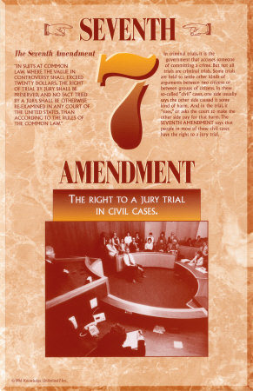
Seventh Amendment
guarantees the right to a jury trial in most civil cases

Slide 18
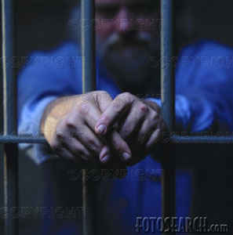
Eighth Amendment
No excessive bail
No cruel and unusual punishment

Slide 19
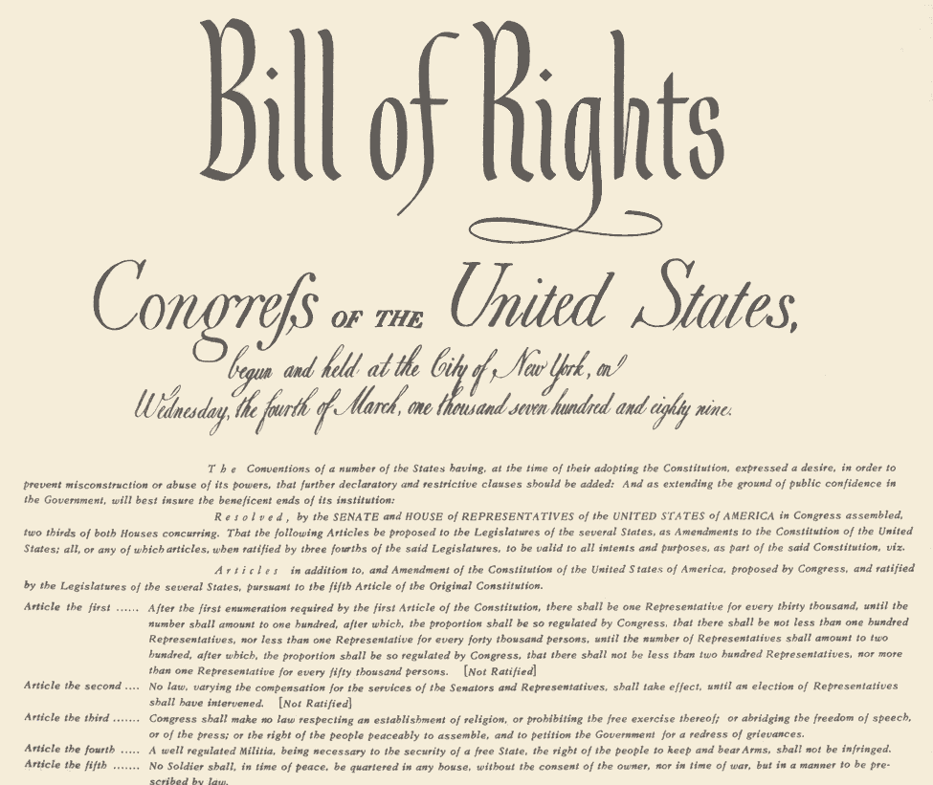
Ninth Amendment
The Bill of Rights cannot deny other rights previously held by the people.

Slide 20
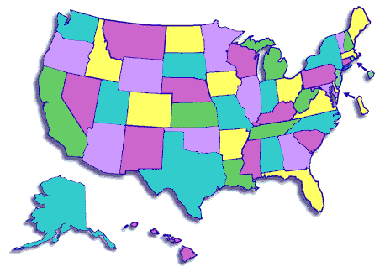
Tenth Amendment
The states remain in charge within their own borders

Slide 21
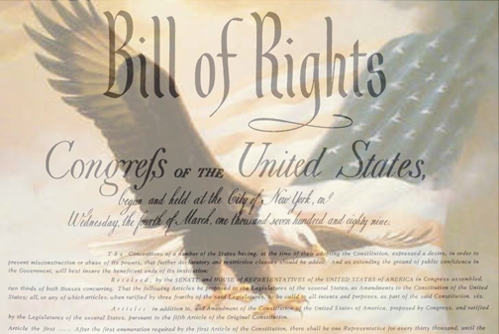
……..protecting our freedoms

Slide 22
